Slide 1
Product Planning with Scrum

Slide 2
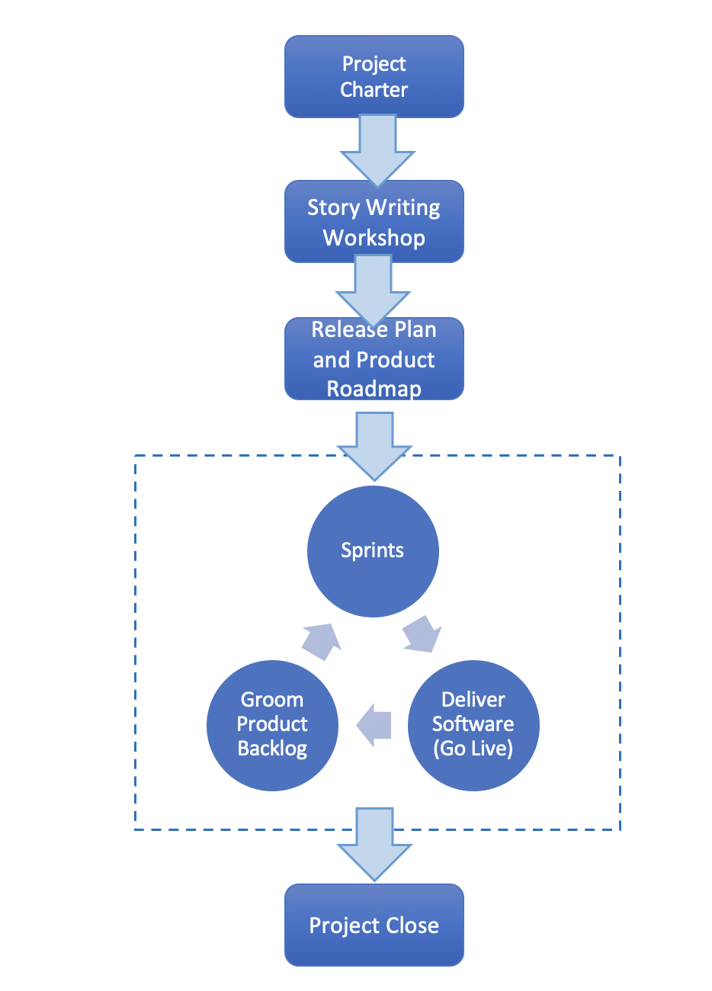
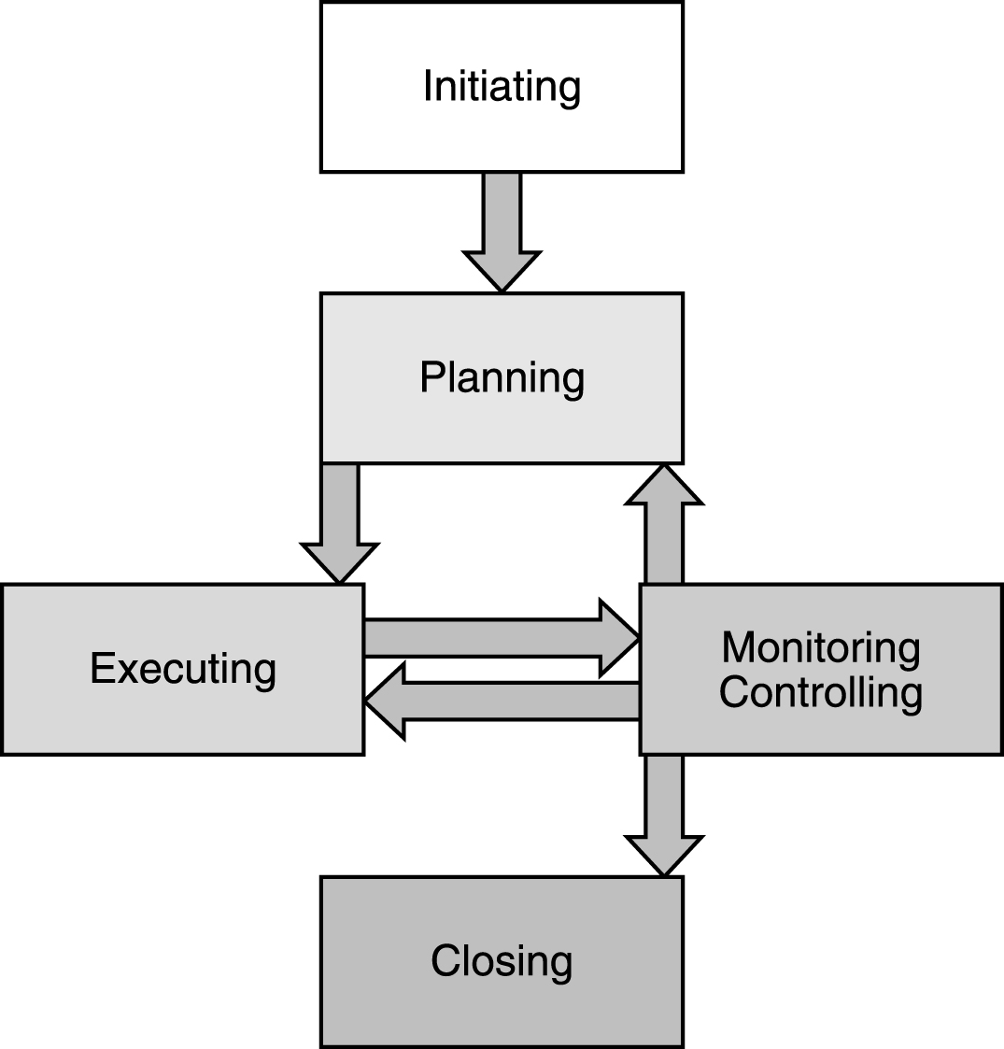
The Project Lifecycle
Planned – PMBOK
Adaptive - Scrum/Agile
PMP in Depth: Project Management Professional Study Guide for PMP and CAPM Exams

Slide 3
Scrum Flow
Project Charter
Business case, high level project scope, major milestones, product vision
User Story Development
Story writing workshops
Product Roadmap and Release Plan
Product backlog grooming
Sprint Execution
Multiple iterations
Release Software
Deploy software to operational environment
Project Close

Slide 4
Product Vision
Clear, concise description of product and product value statement

Slide 5
A “Vision” contains two major components
Envisioned future
Contains Core Values and Purpose
10 – 30 year audacious goal with a vivid description
Core values and vision rarely change
Building Your Company’s Vision, Collins and Porras, 1996
Notes:
Walt Disney
No cynicism
Nurturing and promulgation of wholesome values
Creativity, dreams, and imagination
Fanatical attention to consistency and detail
Preservation and control of the Disney magic

Slide 6
Putting it All Together: Sony in the 1950s
Core Ideology
Core Values
Elevation of the Japanese culture and national status
Being a pioneer – not following others; doing the impossible
Encouraging individual ability and creativity
Core Purpose
To experience the sheer joy of innovation and the application of technology for the benefit and pleasure of the general public.
Envisioned Future
BHAG
Become the company most known for changing the worldwide poor-quality image of Japanese products
Vivid Description
We will create products that become pervasive around the world…We will b the first Japanese company to go into the U.S. market and distribute directly… We will succeed with innovations that U.S. companies have failed at – such as the transistor radio… Fifty years from now, our brand name will be as well known as any in the world
Building Your Company’s Vision, Collins and Porras, 1996

Slide 7
Discussion
Provide an example of software product that has a clear, well defined vision

Slide 8
User Stories and Product Backlog
Prioritized list of product features
Product Backlog Items (PBI)
Size of PBIs are typically measured in story points

Slide 9
Product Roadmap
Release schedule for the product along with major project milestones (e.g. minimum required functionality, market events, architecture, key features, etc.)

Slide 10
Velocity
Velocity is the amount of work completed each sprint
Typically measured in story points
Essential component of product planning
It tells one how much work can be completed each sprint
May be used as a diagnostic
Track velocity over time for each sprint and look for differences

Slide 11
Release Planning

Slide 12
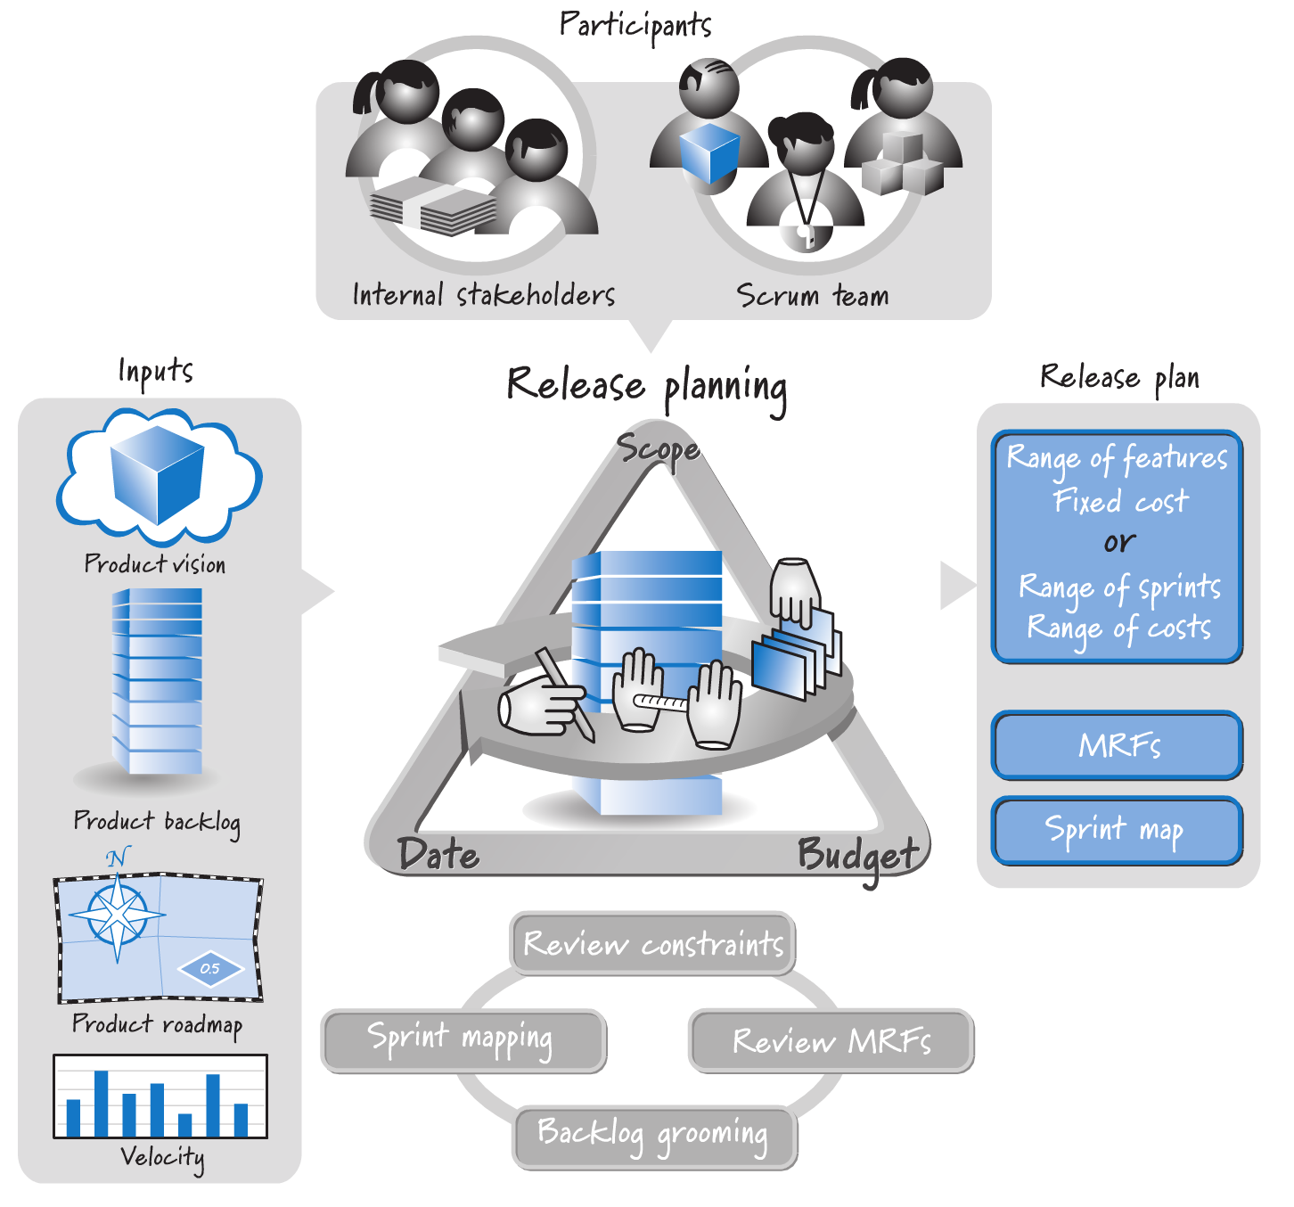
(Source: Essential Scrum, p. 310)

Slide 13
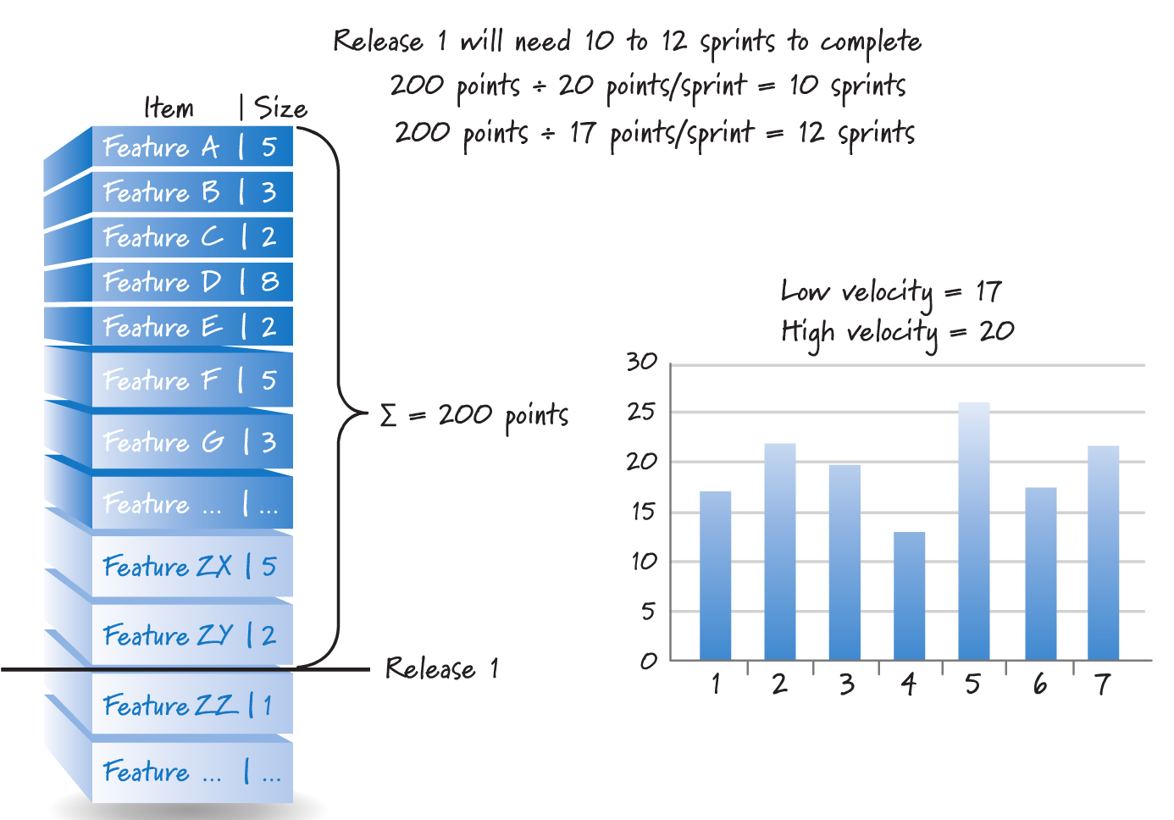
Using Velocity to Plan Release Schedule
(Source: Essential Scrum, p. 134)

Slide 14
Class Exercise
Assume MVP contains 410 story points of work. How long will it take to deliver MVP if velocity is 18 story points per sprint and each sprint is two weeks in duration?

Slide 15
Sprint Planning and Sprint Execution

Slide 16
Sprint Planning
Decide which product backlog items to work on in a given sprint
Requires an understanding of capacity/velocity
Serves as a feasibility check
Output is sprint backlog containing detailed tasks for each PBI
Useful for communication and tracking

Slide 17
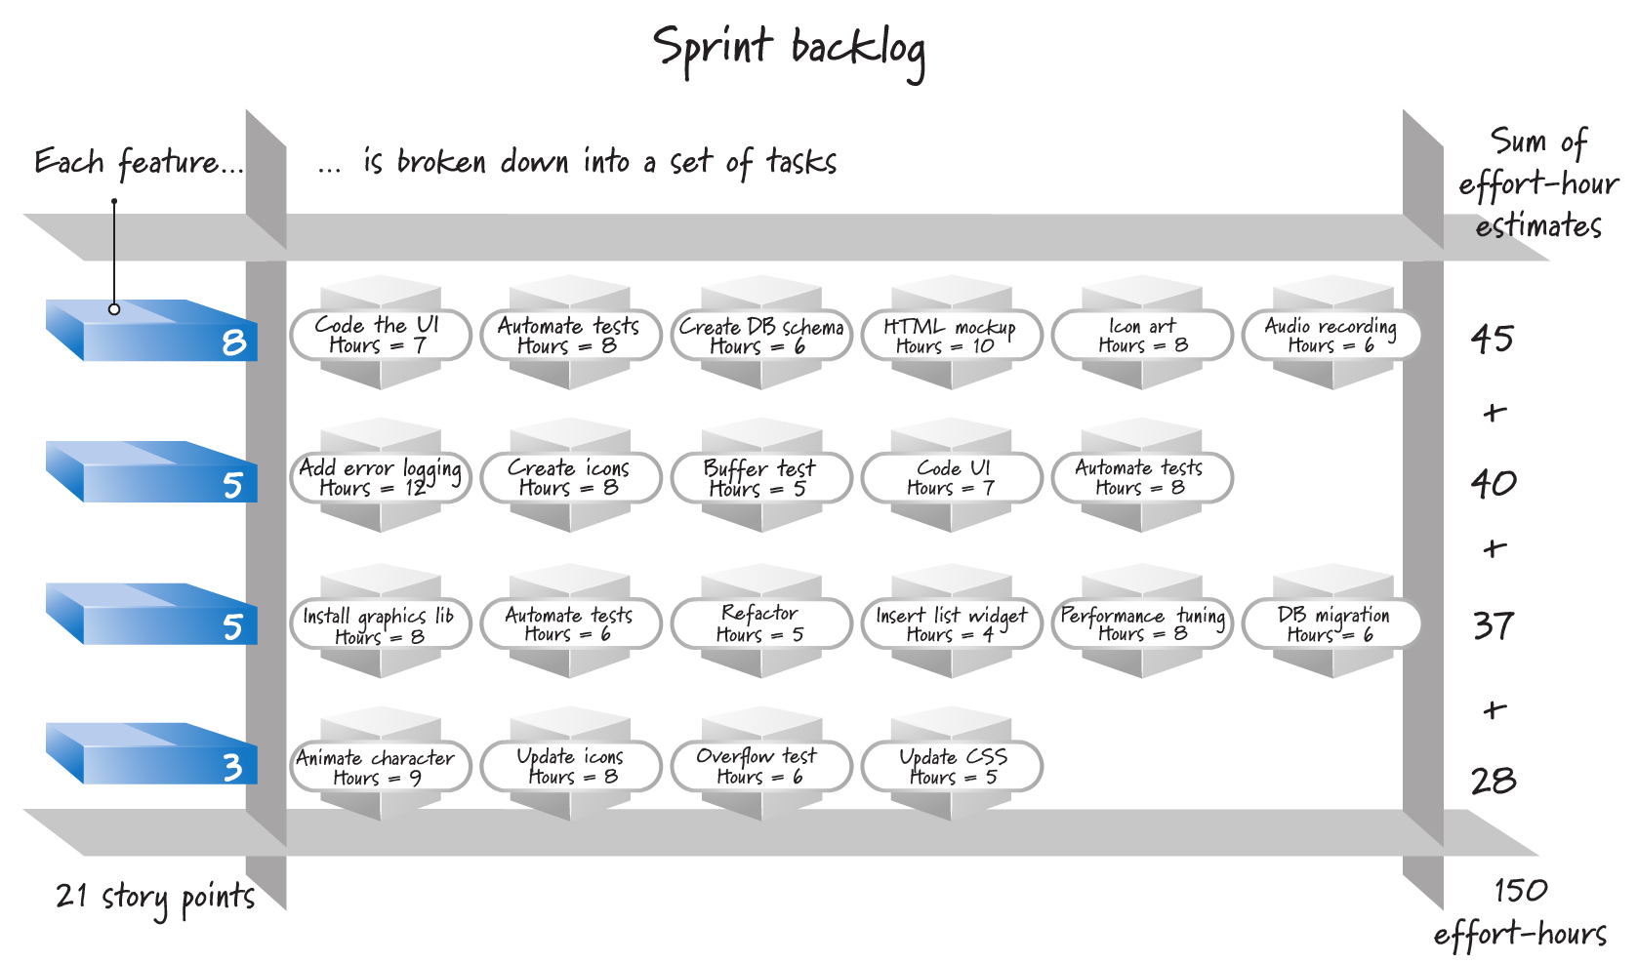
Sprint Backlog
(Source: Essential Scrum, p. 345)

Slide 18
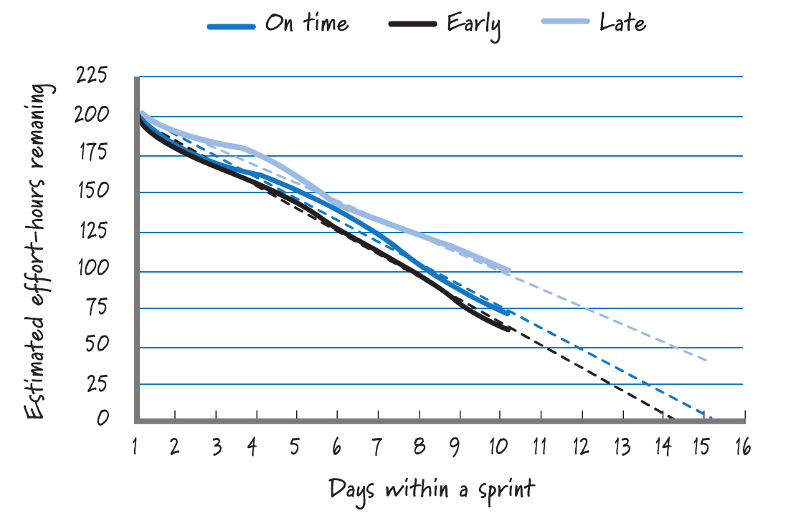
Using Velocity as a Diagnostic During Sprint Execution
(Source: Essential Scrum, p. 359)

Slide 19
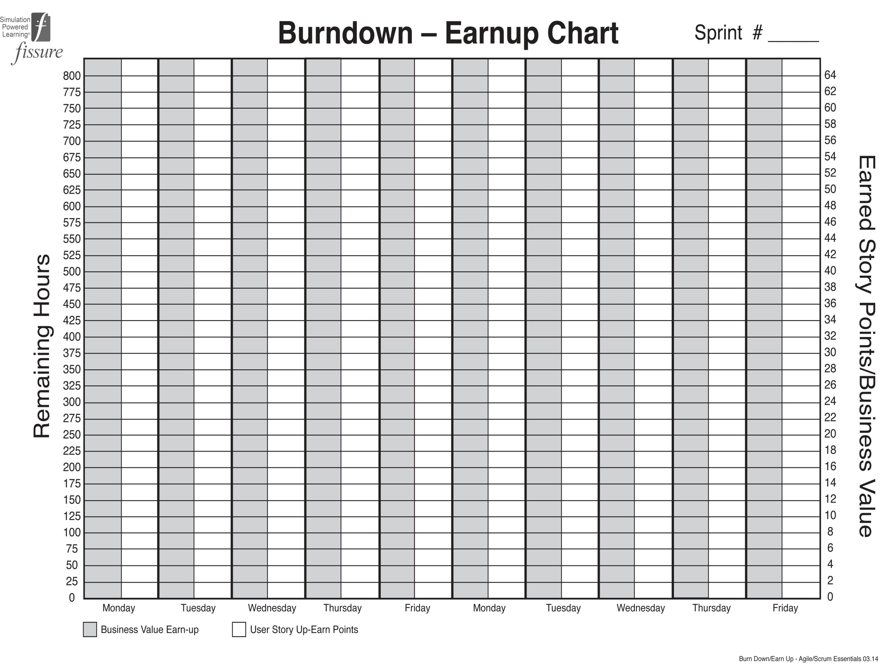
Total hours of all user stories at the beginning of the sprint
Remaining hours of all user stories at the end of each day
Cumulative total of business value points
earned to date
Cumulative total of user story points
earned to date

Slide 20
Using Velocity as a Diagnostic
Useful for comparing output of multiple sprints
Useful for release planning
Should not be used to assess performance
Difficult to use between Scrum teams

Slide 21
Release Planning Software Tools
Version One
Scaled Agile Framework
Jira Software
Azure DevOps

